Slide 1
Advanced Data Structures and Algorithms
Advanced Data Structures and Algorithms
Lecture 1 – Introduction
Miao Zhang

Slide 2
General Information
Professor: Miao Zhang
Class room: B-205
Contact: miaozhang@dlut.edu.cn Informactics Building #317
Office Hours: By appointment. (I am usually here Mondays through Fridays, all day, and I can usually meet anytime I am not in class.)
Class Schedule:
Lecture: 1-8 weeks; every Tuesday and Thursday until Oct. 27

Slide 3
General Information
qq group： 423528761 （required）
the course will be open on every Monday until Nov. 1
Website: https://www.icourse163.org/
(You are provided with the instruction in MS Word format)
Online Lab assignment
Website: https://classroom.devcloud.huaweicloud.com/
(You are provided with the instruction in MS Word format)

Slide 4
Prerequisites
Data Structures and Algorithms 1

Slide 5
Course Description
Data structures play a central role in modern computer science.
This course covers major results and current directions of research in data structures.
It introduces methods for organizing data so that the data can be accessed and updated efficiently within a computer program.
Particular emphasis will be placed on handling data that represent geometric items such as points and lines.

Slide 6
Course Objectives and Learning Outcomes
Describe the properties, interfaces, and behaviors of basic abstract data types, such as collection, bag, indexed collection, sorted collection, stack, and queue.
Read an algorithm or program code segment that contains iterative constructs and analyze the asymptotic time complexity of the algorithm or code segment.
State the asymptotic time complexity of the fundamental operations associated with a variety of data structures, such as vector, linked list, tree, and heap.
Recall the space utilization of common data structures in terms of the long-term storage needed to maintain the structure, as well as the short-term memory requirements of fundamental operations, such as sorting.
Design and implement general-purpose, reusable data structures that implement one or more abstractions.
Compare and contrast the operation of common data structures (such as linear structures, priority queues, tree structures, hash tables, maps, and graphs) in terms of time complexity, space utilization, and the abstract data types they implement.

Slide 7

Textbooks
《数据结构、算法及应用》. 张宪超 主编. 科学出版社. 2012

Slide 8

References: [Optional]
Data Structures and Algorithm Analysis by Clifford A. Shaffer (ISBN: 978-0-486-48582-9)

Slide 9
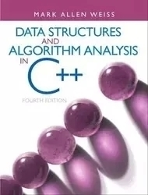
References: [Optional]
Data Structures and Algorithm Analysis in C++ (4th Edition) by Mark Allen Weiss, Pearson (ISBN 0-13-284737-X)

Slide 10
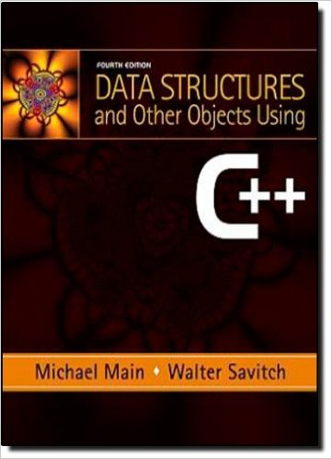
References: [Optional]
Data Structures and Other Objects Using C++ by Michael Main and Walter Savitch, Addison Wesley, 2010. （ISBN 0-13-212948-5）

Slide 11

References: [Optional]
《数据结构》. 严蔚敏著.清华大学出版社

Slide 12
Grading Policy:
Grades will be derived from homework assignments and exams. The detailed weightings and letter grades are as such:
Online Test: 5% (You are allowed to take each online test three times. The highest scores will be picked through 3 attempts ) Icourse
Online Homework: 5% Icourse
Online Lab Assignment: 5% Huawei cloud
Lab Assignment: 15%
Attendance: 10%
( you have to check your attendance on QQ )
Final Exam (paper based exam): 60%
You must receive a score of 60% or higher to pass the class
** The grading policy applies to all the students including ones retaking this class.
X% | Grade
x <= 95 | A+
90 <= x < 95 | A
85 <= x < 89 | B+
80 <= x < 84 | B
75 <= x < 79 | C+
70 <= x < 74 | C
60 <= x < 69 | D
x < 60 | F

Slide 13
Topics:
Algorithm Analysis (Spring Semester)
List, Stacks, and Queues (Spring Semester)
Binary Trees (Spring Semester)
Graphs (Fall Semester)
Searching (Fall Semester)
Sorting (Fall Semester)
Theory of Algorithms & Patterns of Algorithms (Fall Semester)

Slide 14
Attendance is mandatory:
For every lecture/lab that is missed, you will lose one point from your final grade (e.g. a 90 becomes an 89). if you miss the class for the second time, then you will lose 1.5 points from your final scores, if you absent from the class for the third time, then you will lose 2 points. The only exceptions are if you notify me prior to your absence with a valid reason. (Sleeping, studying for another class, working on your game, etc., are not valid reasons for an absence.) Class participation will boost your grade if you are on the border. (e. g. It is possible to get an A with an overall average of 89%)
**If you have been caught for more than 3 times, you are disqualified for this class

Slide 15
Workload
During the semester there will be one major exam ( final), several short quizzes and/or short in-class programming assignments during the labs. There will be several programming assignments to work on outside of class. These are not large and you will usually have one to two weeks to complete them (although they generally take no more than a few hours to complete). In addition to attending the lectures/labs, you should plan to spend at least 6 hours per week reading, studying, and programming for this class.

Slide 16
Late Policy
Late homework will be accepted only with prior approval by the instructor. The approval must be issued at least 1 day before the deadline, unless in the case of emergency. Otherwise, there is ZERO tolerance for late homework It is your job to get work in on time. Sometimes the network or website is down. Avoid these issues and turn assignments in early.
**Any type of late homework will not be accepted

Slide 17
Classroom Policy
During class, all electronic devices must be turned OFF or stay silent. This includes cell phones, ipad, game consoles, digital cameras, laptop computers or any other devices. If you absolutely must have a cell phone on for an emergency situation, you must first clear it with me BEFORE class begins.
In addition to showing up for class on time, other student responsibilities include proper behavior during class, learning the material, completing assignments correctly, submitting assignments properly and on time, studying for the exams, and participating in class by asking or answering questions during the lectures.
Finally, all students are required to bring a pencil (or other writing instruments) and paper to class to take notes, quizzes and perform other tasks.

Slide 18
Academic Integrity Policy
All homework assignments and exams must represent your own, individual work.
Cheating of any kind (copying someone else's work, allowing others to copy your work, collaborating, etc.) will not be tolerated and will be dealt with SEVERELY (at the discretion of the instructor, which usually includes removal from the class with a grade of F.)

Slide 19
Homework Help
You are encouraged to study together and to discuss information and concepts covered in lecture and the sections with other students. You can give "consulting" help to or receive "consulting" help from such students. However, this permissible cooperation should never involve one student having possession of a copy of all or part of work done by someone else.

Slide 20
How to Succeed in This Class
Read the assigned reading before and after the class.
Pay attention and participate in the class discussions.
Asking for permission vs Asking for forgiveness →permission always wins!
If you don’t understand something get help early

